Slide 1
Japanese Alphabets
In Japanese has three writing system
1- Hiragana
2-Katakana
3- Kanji
Hiragana- this alphabet use for Japanese words for example : Japanese people’s name , Japan cities name, Japanese MNC’s etc. in hiragana has 46 alphabets.
Some example of hiragana words looks like - あ (Aa),い(e),う(u),え(ae), お (O).
2. Katakana – In Japanese has some words adopted from other languages, so this type of words is written in katakana. For example: Non-Japanese native’s name, other language words, other countries name etc. in katakana has 46 alphabets.
Example of katakana- ア (Aa), イ(e),ウ(u),エ(ae),オ(O)

Slide 2
3. Kanji
Kanji means Chinese script and adopted from Chinese language, it makes easy to read and understand the Japanese words in symbol.
For JLPT N5 ( Beginner level) required minimum 100 kanjis we have to remember.
Some examples of kanjis:- 日 , 週, 月, 年, 何, 今

Slide 3
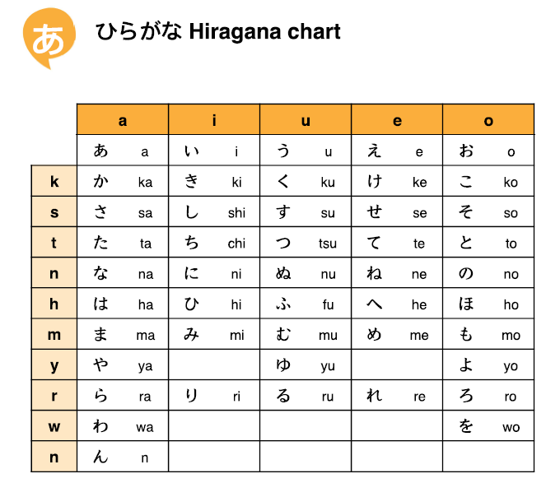
1. Hiragana

Slide 4
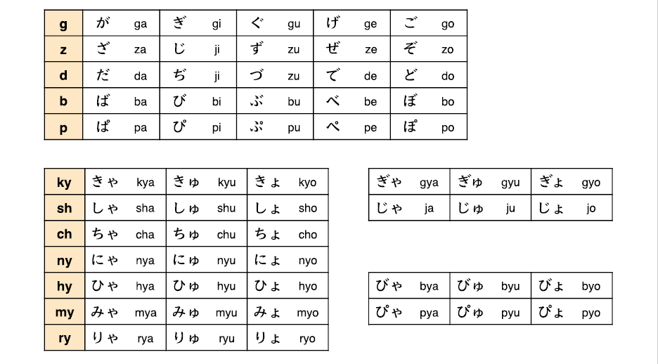

Slide 5
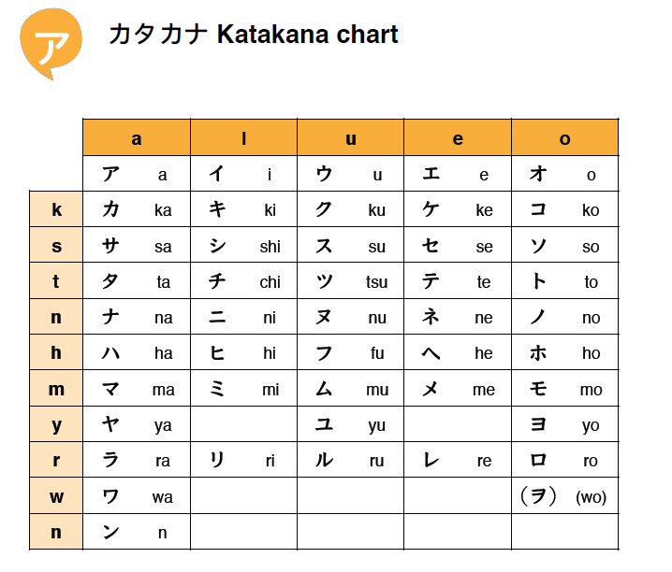
2. Katakana

Slide 6
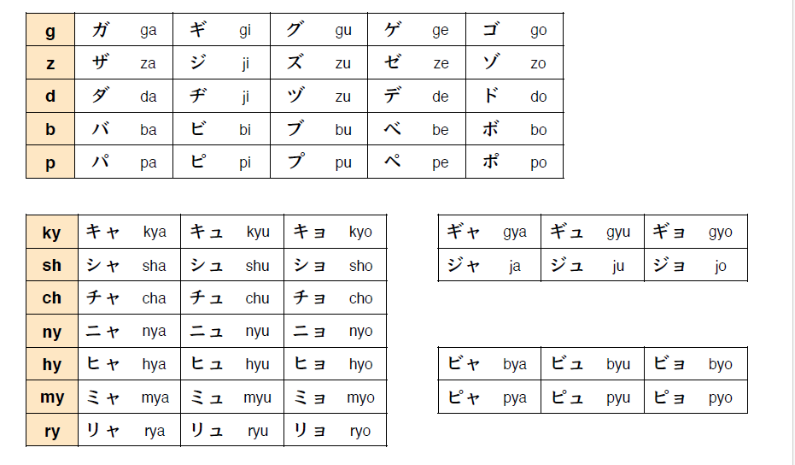

Slide 7
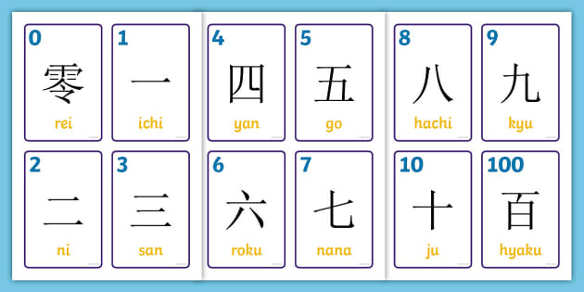
3, Kanji for beginners level

